Slide 1

ECE3141 Network and Information
Effects of Search Algorithm and Block Sizes on Video Motion Compensation
BY: JED WONG, MATTHEW GU
Notes:
Good Morning, everyone. Today, we're here to discuss our research on the performance of motion compensation in video compression, specifically through varying block sizes and exploring the differences from different matching algorithms implemented.

Slide 2


What is Motion Compensation?
Notes:
Now before we dive into our findings, lets understand How Motion compensation works?
Lets says we have a continuous chunk of video and we take two consecutive frames out for comparison, we can see that there is only a slight difference in them. Motion compensation leverages this property to reduce the amount of information that needs to be transmitted or stored.

Slide 3

What is Motion Compensation?
Motion Estimation
Current Frame
Next Frame
Notes:
Now instead of transmitting all the the RGBs in this very next frame, motion compensation divides the video frames into small blocks, and use block matching algorithms to find the best matching block in a previously sent reference frame for each block in the current frame. Motion compensation will look into the next frame of same coordinates and compare which of the neighbouring pixels matches closest to the pixel in the next frame. Once, it has been found, a motion vector will be drawn.

Slide 4
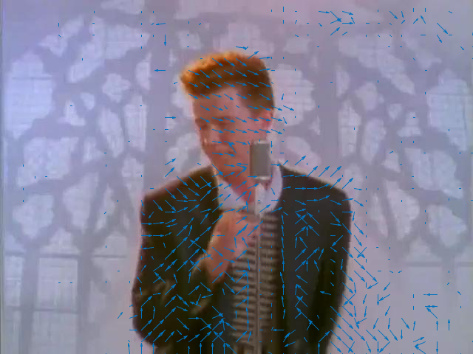


What is Motion Compensation?
Motion Vector
Predicted Next Frame
Notes:
As we repeat this process over some predetermined amount of pixels eventually we will get this motion vector. After all the shifting, we will be able to compute a predicted frame. However, as we can see this predicted frame it is still very pixelated and not a clear representation of the next frame.

Slide 5
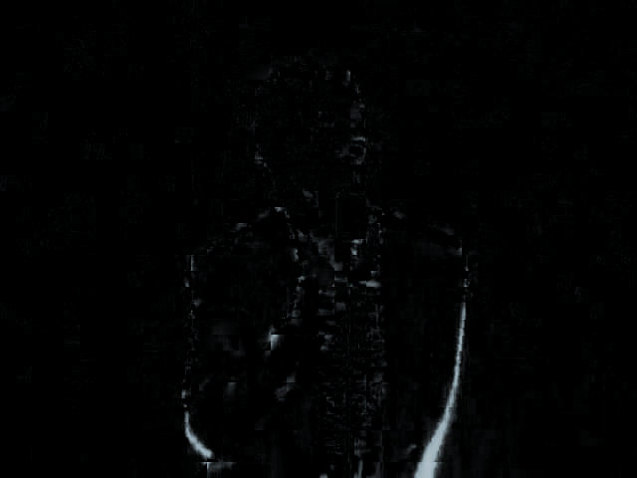
Original Next Frame
Predicted Next Frame
-
=
Notes:
Hence, the difference between this predicted frame and the next frame is computed which looks something like that. Only the difference between consecutive frames and the motion vector will be transmitted. This results in significant compression in video transmissions and storage.

Slide 6
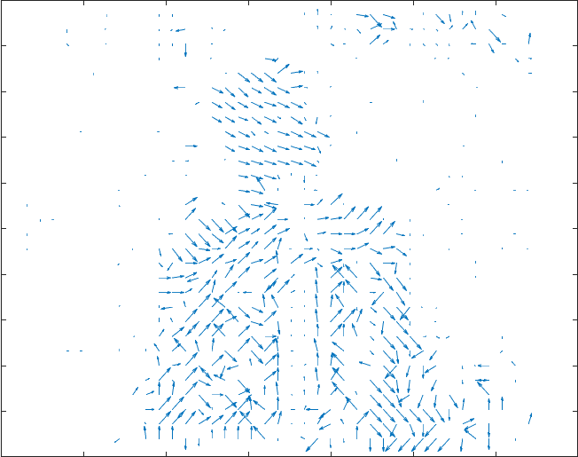
Motion Vector
Difference between Predicted and original Next Frame

Slide 7

Type of search algorithm implemented
Exhaustive Search
Current Frame
Next Frame
= one pixel (For illustration purposes)
Notes:
The block matching part accounts for the majority of the computation in MC. And we investigated three different algorithms for matching.
The first one, ES, is the simplest form. We define a range of pixels to search in.
Compare the target block to every possible block in the range and use the closest matching one as the prediction.
It guarantees optimal choice, but at a huge computational cost.

Slide 8
Type of search Algorithm
Three Step Search (TSS) Search
Current Frame
Next Frame
= one pixel (For illustration purposes)
Notes:
On the flip side, we have TSS.
The process goes as follows:
We compare the target block to the center of search range and all 8 blocks 4 pixels up down left and right. This is the first step, with step size of 4 pixels
From there, we pick the closest matching block as our new center, and performs the same comparison up down left and right, but this time with step size of 2 pixels
This is repeated for step size of 1 pixel, and the best matching block found in the process is used.

Slide 9
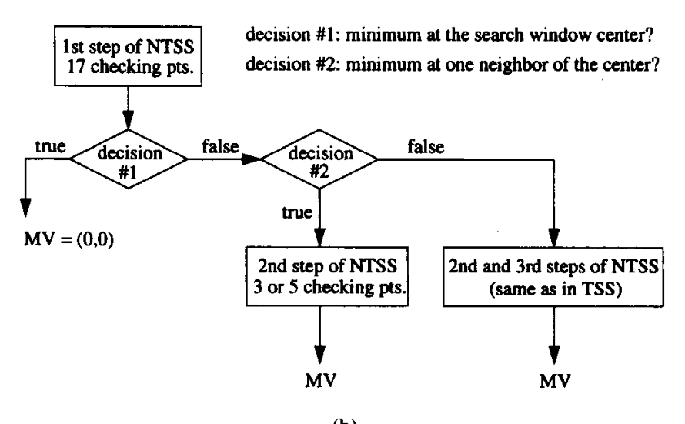
Type of search Algorithm
New Three Step Search (NTSS)
Current Frame
= one pixel (For illustration purposes)
Notes:
The final search, NTSS extends up TSS where it introduces an additional step at the start and an early stopping mechanism.
In the first step, in addition to the blocks 4 pixels away, we also check the immediate neighbours 1 pixel around the center.
If the best match is found at the 4 pixel step, regular TSS continues.

Slide 10
Type of search Algorithm
New Three Step Search (NTSS)
Current Frame
= one pixel (For illustration purposes)
Notes:
If the best match is the center, the algorithm ends straight away
If the best match is in the immediate neighbours, another search of step size of 1 is performed before termination.

Slide 11
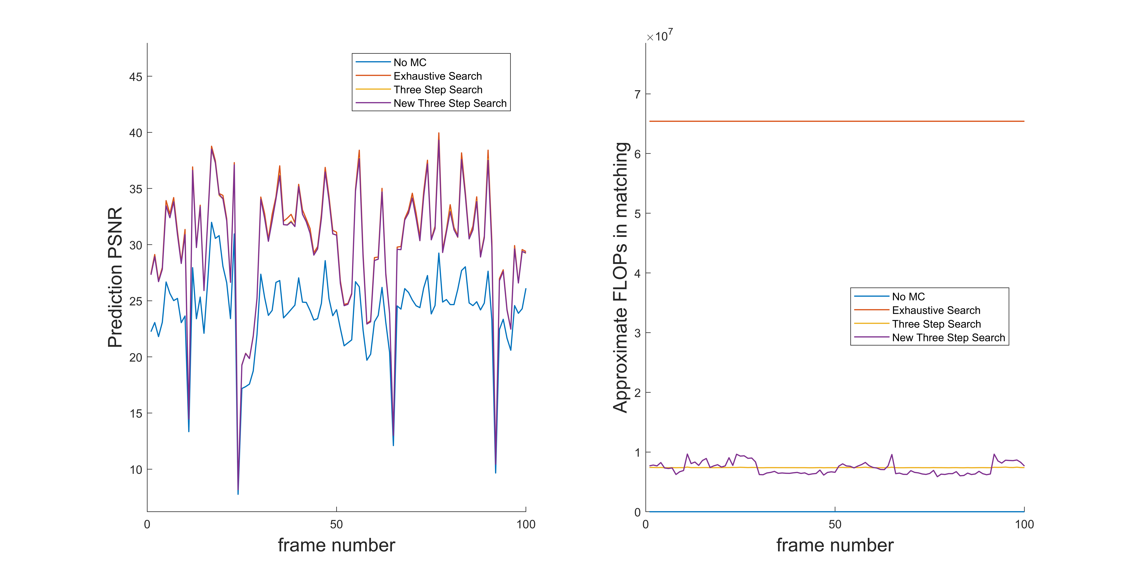
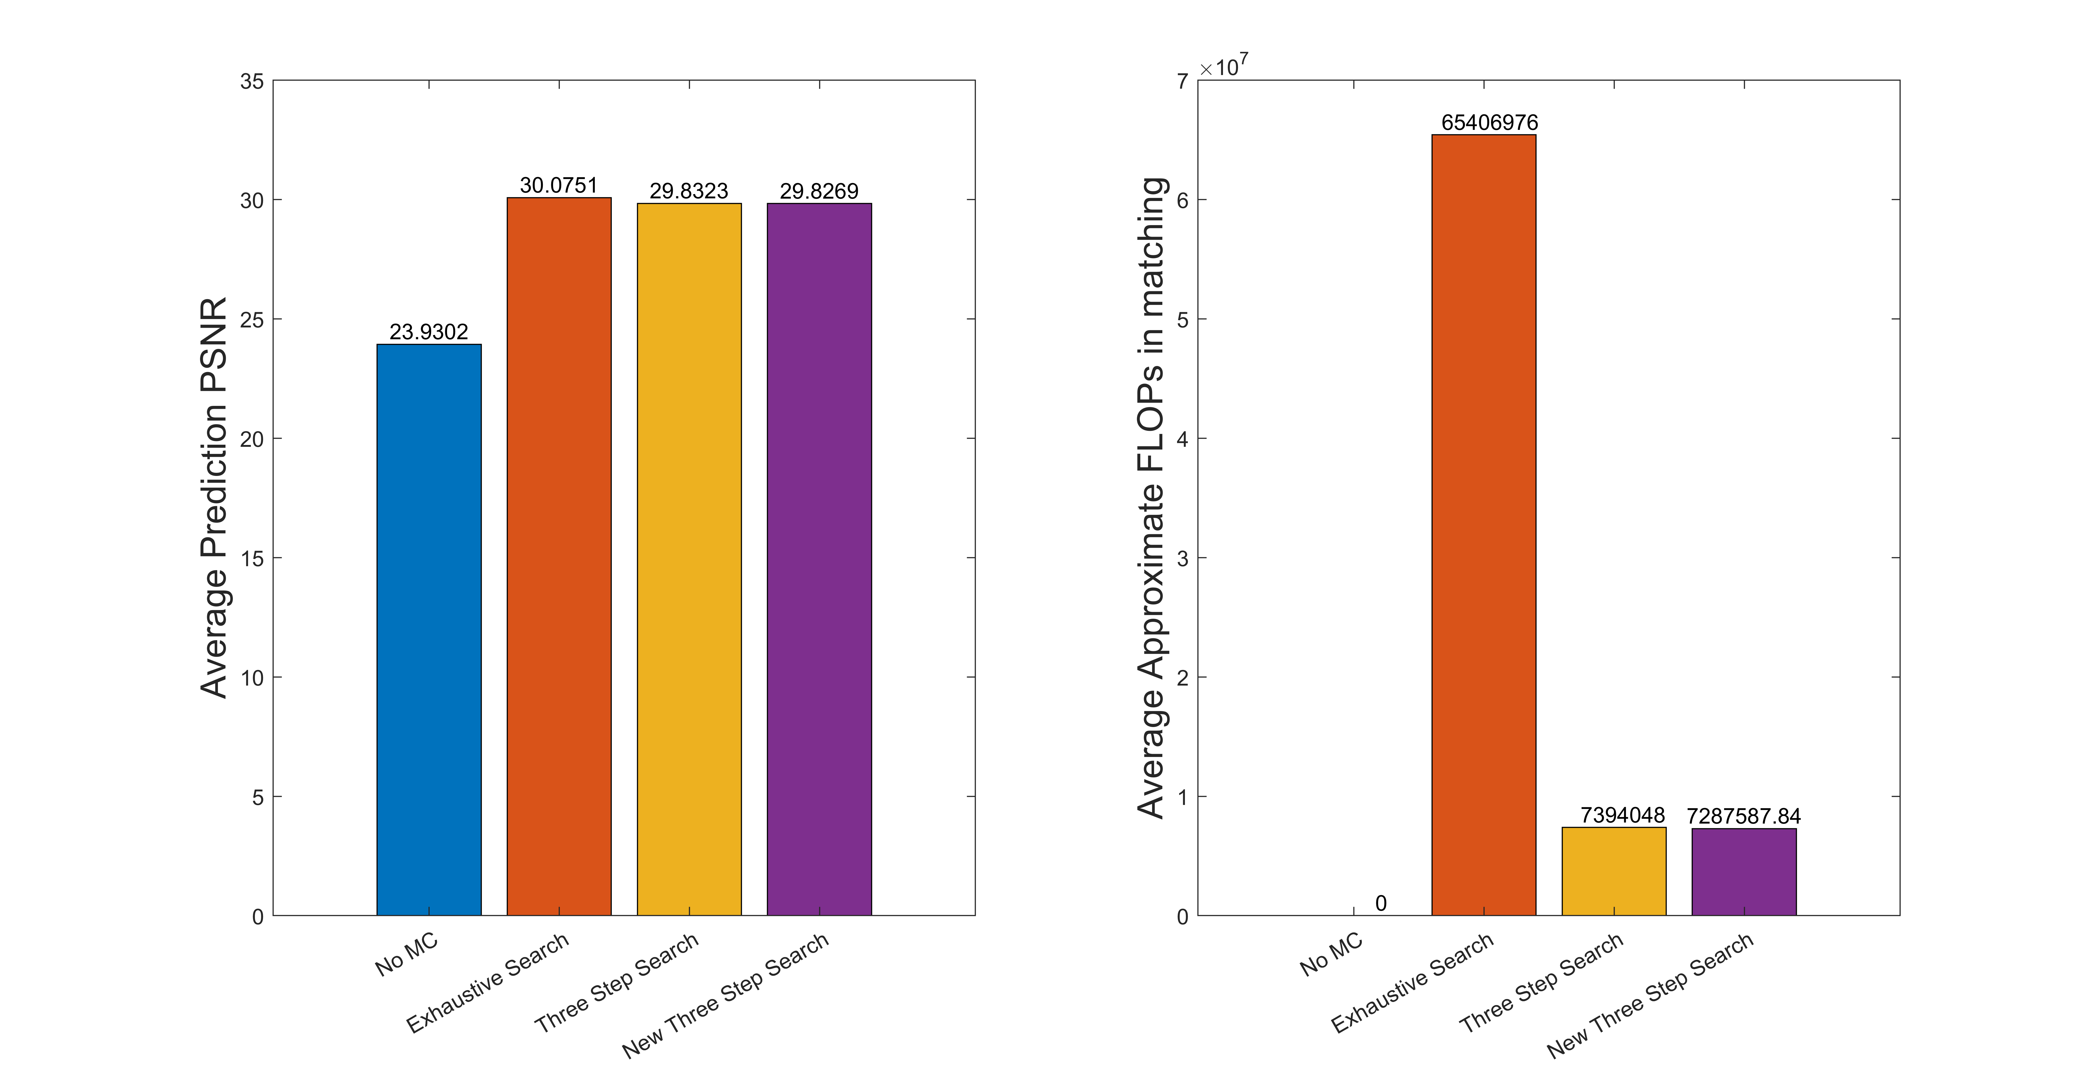
Effects of Search Algorithm on Prediction Peak-Signal-to-Noise-Ratio (PSNR)
A measure of accuracy of motion estimation, the higher the better
* Blocks size = 16, search range = 7
Notes:
Using the first 200 frames, we measure the Peak SNR, a measure of the accuracy of the BMAs.
In addition to the algorithms we introduced, doing no search at all, NO MC, is also included for reference, and can be seen to be a poor choice for video compression. (having marginally lower PSNR)
What was found, was that ES as expected defines an upper bound for accuracy.
TSS performing 0.8% worse ES, with NTSS performing 0.018% worse than TSS.

Slide 12
Effects of Search Algorithm on Number of Floating-point Operations in Each Block Matching
A measure of computation cost of motion estimation, the lower the better
* Blocks size = 16, search range = 7
Notes:
Computation cost in terms of floating point comparisons during block matching is also compared.
As you can see, the 0.8% accuracy lead of ES comes at a cost of 800% more computation cost.
NTSS’s early stopping mechanism and the checking of the immediate neighbours makes it more sensitive to local motion, and reduces computation cost by about 5%.
In the BMAs studied, NTSS provides the best tradeoff between accuracy and computation cost.

Slide 13
Change in Block Sizes
Notes:
Now apart from that, We have also varied the block sizes observe their corresponding effects on its processing complexity and the accuracy of estimated frame generated.
From this we would expect to have a more clear replication of the next frame as we are repeating the block matching algorithm more frequently. (Which means, a higher PSNR would be expected as we decrease the block sizes but also an increase in computational cost ).

Slide 14
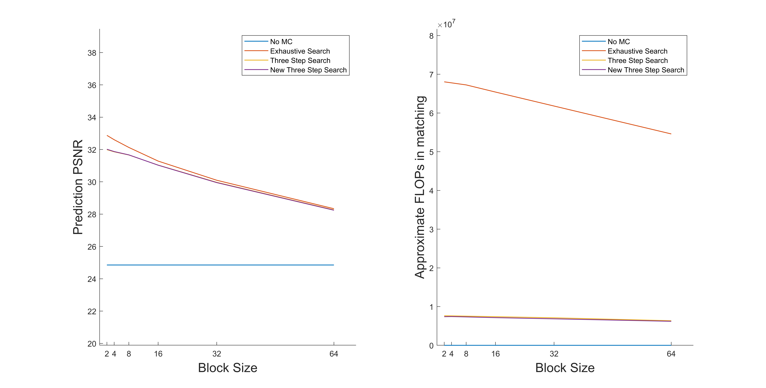
Effects of Different Block Sizes on Average PSNR and FLOPs in the First 200 Frames
Notes:
And it turns out that our findings does corresponds to what we would’ve expected with block sizes being inversely correlated with both the accuracy as well as the computation cost.
An interesting thing to note of is the slight deviation between ES and the two other searches.
A possible explanation would be that, regardless the block sizes TSS and NTSS would only have to search through the 25 preallocated pixels at worst, whereas ES would have to search through all of the pixels contained within its search area, which gives it the ability to replicate more accurately, however there is a tremendous differences between there computational power.

Slide 15
SUMMARY
Search algorithms cleverly trades accuracy for lower computation cost.
ES guarantees the best accuracy, and is an upper bound for BMA accuracy.
In the three algorithms investigated, NTSS is the most cost efficient one.
Block sizes is another option to balance cost and accuracy. It is generally negatively correlated with the two parameters.
Notes:
So, in this project, we found that
Out of all BMAs seen here, no MC is a poor choice for compression, ES gives the best accuracy, while NTSS is the most cost-effective algorithms
Blocks sizes can also be altered to increase accuracy at the cost of more computation, and vice versa.
Depending on the aim, one can pick different approaches and parameters to balance out the compression rate of MC and the computation cost.

